Slide 1
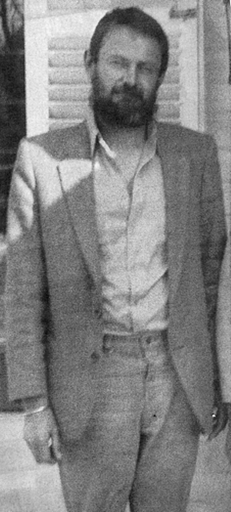
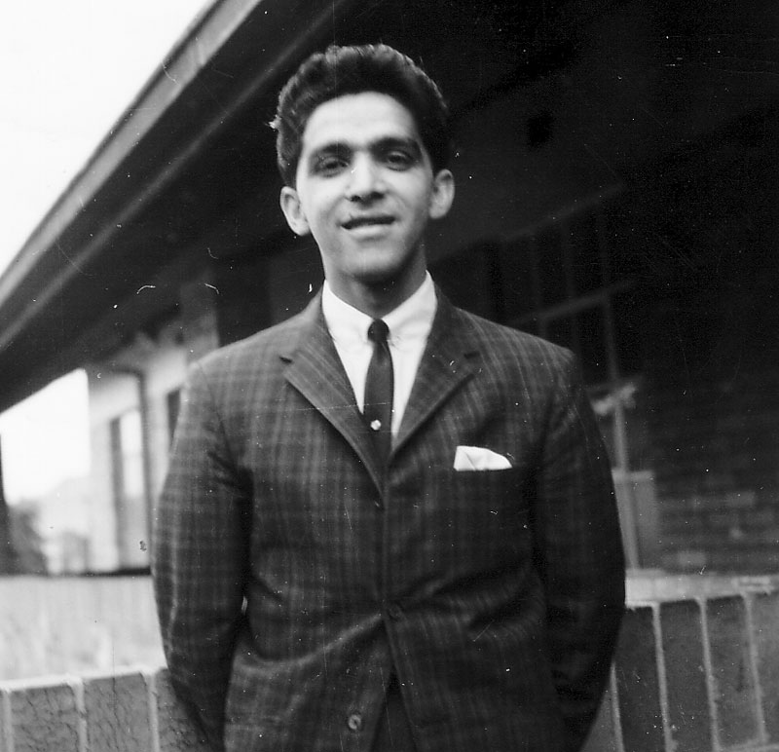
Revisiting the Deaths of Ahmed Timol & Neil Aggett
Notes:
Howard – Introductory statement

Slide 2
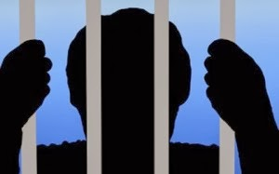
Detention without Trial
Notes:
Before starting this presentation we should reflect on the role detention without trial played in maintaining the apartheid system.
Detainees had little or no rights.

Slide 3

South African Political/Legal Landscape during the Apartheid Era
Notes:
Let us also remind ourselves very briefly of the political circumstances of the time: the draconian methods available to suppress opposing views; the absolute belief amongst Security Branch policemen and most other white South Africans that the country was facing a total onslaught; the SB belief that illegal strong-arm methods justified the means.
One should also consider that the apartheid system did not encourage or promote independent, free-thinking Magistrates – especially in politically charged matters that came before them. Magistrates were very much part of the South African apartheid system.

Slide 4

The purpose of this presentation is to demonstrate that the judicial findings in respect of at least two of the deaths in detention are wrong and unjust.
Notes:
Over 50 people died whilst in detention. This does not include the deaths of persons who were in the illegal custody of Security branch members. According to TRC statistics there were 200 admitted deaths of this nature .

Slide 5
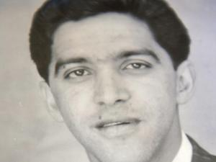
The Death of Ahmed Timol whilst in detention on
27 October 1971
V
Notes:
Ahmed Timol was a teacher in Roodepoort and a member of the South African Communist Party (SACP). He was engaged in the clandestine distribution of SACP propaganda leaflets. He was 30 years old when late at night on 22 October 1971 he was arrested together with his friend and corroborator, Salim Essop. It was alleged that SACP leaflets were found in the boot of the car that they were driving. Both men were detained in terms of the Terrorism Act 83 of 1967 and held and interrogated at the Security Branch offices on the 10th floor of John Vorster Square. On 27 October 1971 (five days after his detention) Ahmed Timol’s body was found on the ground at John Vorster Square after apparently falling from a window on 10th floor. It was alleged by SB that he had committed suicide.
He became the 22nd person to die in Security Branch detention.

Slide 6
The Death of Neil Aggett whilst in Detention on 5 February 1982
Notes:
Neil Aggett was a medical doctor and an organiser for the Transvaal Brach of the African Food and Canning Workers’ Union (AFCWU). Aggett was detained for his role in labour organisation on the 11 December 1981 in terms of Section 6 of the Terrorism Act 83 of 1967. He was initially held at the Pretoria Central Prison and later transferred to the Security Branch detention at John Vorster Square in Johannesburg where he was continuously interrogated. On the 5 February 1982 he was found hanging in the Security Branch cells at John Vorster Square. He was 28 years old. It was alleged that he had committed suicide.
He was the 51st person (and first white person) to die in detention.

Slide 7
After formal hearings the respective Inquest Courts found that both men had committed suicide.
Moreover, the SB were found to be blameless in respect of both deaths
Notes:
Legally the police were responsible for both the physical and mental well being of all detainees.
SB members claimed that detainees (including Timol and Aggett) were always treated with the utmost consideration.
These findings have always been regarded with sceptism

Slide 8

People remain sceptical about these judicial findings and suspect that the isolation of the detainees allowed Security Branch members to present a unified version of denial.
Notes:
The so called “wall of silence”

Slide 9

The Acid Test
Notes:
If the inquiry should show that SB detainees were humanely treated - then that is the end of the matter.
If, on the other hand, it is shown that torture was routinely practiced by SB members, and that Timol and Aggett were victims of torture, then the possibility of murder cannot be ruled out in either of these cases.
Moreover if torture was present then the Inquests did not adequately serve justice. Their deaths should be revisited and closely examined. STRESS LIMITS OF MY INQUIRY i.e. interviews not affidavits; also only presenting information concerning ill treatment and torture – my investigation has been much wider than this and at the appropriate time I can share these aspects with the official investigation team.

Slide 10
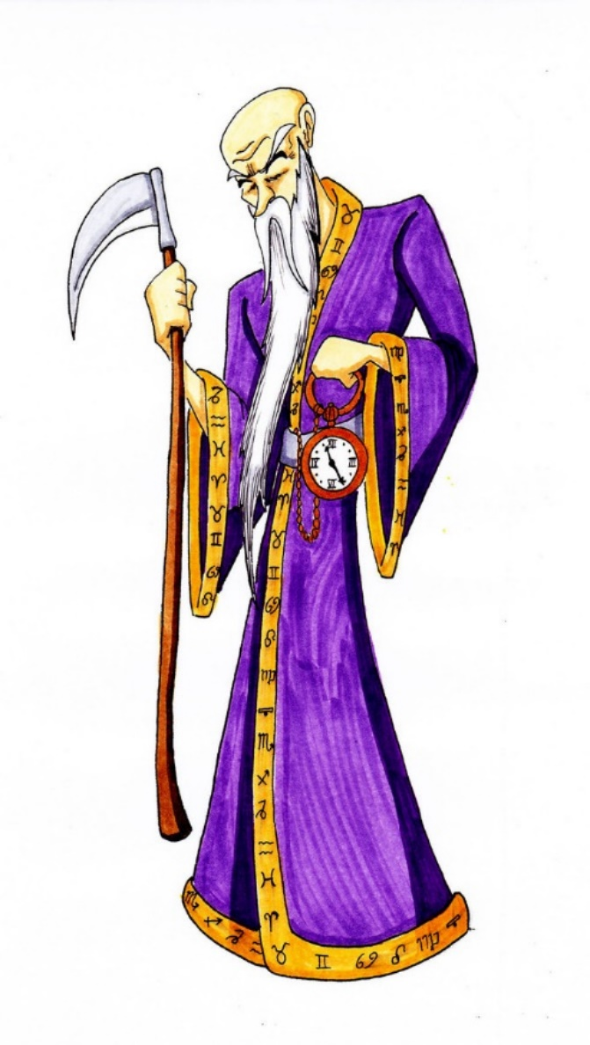
Challenges of the Timol Death
. . . and to a lessor extent the
Aggett death
Notes:
Deaths of witnesses and potential witnesses
Records no longer available
Suspects deceased
Memories faded etc.
BUT despite these difficulties it is not too late to find the truth of these matters.

Slide 11
The need to revisit these Inquests must be based on
New Evidence
Notes:
I therefore do not dwell on information or evidence that was available to the families and their council at the time of the Inquests or on evidence that was presented to the Inquest courts.

Slide 12
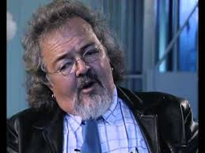
Paul Erasmus – a former John Vorster Square SB member
Notes:
Erasmus testified before an Amnesty Committee of the TRC on 16 October 2000. He provided corroboration in the form of documents to much of his testimony of the cover-up by the SB of the true circumstances that led to Aggett’s death. According to him the conspirators included the most Senior Commanders of the Police at Pretoria HQ and also included the SB members at John Vorster Square.
Erasmus also told of George Bizos’s office being bugged to allow SB members to eve-drop on confidential consultations and conversations to give SB members the opportunity of countering the family’s efforts to expose the truth and to counter defence strategies.
Erasmus also testified about SB members rehearsing their evidence according to a carefully developed false version of events by very senior police officer.
Can Erasmus’s version be corroborated?

Slide 13
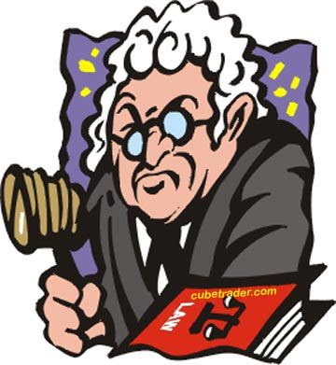
It has, over the past 20 years, been shown that
the Security Branch had NO qualms about
presenting false versions to Judicial Hearings
Notes:
The TRC, Eugene de Kock, Harms Commission, Steve Biko Inquest to name a few incidents

Slide 14
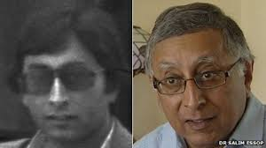
Dr Salim Essop
Notes:
A witness who could have provided valuable insight to the Inquest Court into the interrogation methods of the SB was Salim Essop, the young man who was arrested together with Timol. He however could not be called as a witness as he was in detention and not allowed the right of legal representation; or to testify in open court or even to communicate with the outside world.

Slide 15
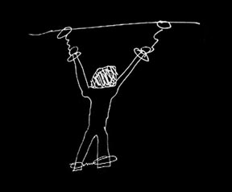
Essop’s Account of Torture
Notes:
He was viciously assaulted and tortured from the moment he came into the hands of the SB, physically assaulted, sleep deprivation, prolonged standing, awkward postures, arms outstretched, suffocated, electric shocks, dangled over stair well, urinated ON
Four days of his arrest had to be hospitalised after he fell into a coma with head and other injuries. The District Surgeon, Dr Kemp, had been urgently summonsed to attend to Essop who he found comatose in a passage of John Voster Square. Dr Kemp listed 16 injuries to Essop. These injuries were corroborated by a neurosurgeon, Dr Law, who treated Essop.

Slide 16
Why is this “new” Evidence?
Why was this evidence concealed from the Inquest Court?
Notes:
Essop has never made an affidavit or testified about his experience. Describe detention, court, 10 year sentence, immigrated to UK. Not prepared to testify before TRC.
New Life
Trauma of torture
He was hidden from the Inquest– despite the obvious relevance of his evidence, the Investigating Officer (who was supposed to be independent) never disclosed his torture and never made him available to Inquest court. This they said was in the interest of National Security. Yet months later Essop stood trial in open court – without concerns of National Security.

Slide 17

Former Security Branch Members who served at John Vorster Square
Notes:
I have traced more than a dozen former members of SB who were stationed at JVS. I have spoken to most of them. Some are keen to talk whilst others are reluctant to talk.
I NOW ALSO HAVE THE NAMES OF TWO MEMBERS WHO ARE STILL ALIVE AND WORKED AT JVS IN 1970 and am in the process of meeting with them.

Slide 18
Magezi Eddie CHAUKE
Joseph NYAMPULE
Adonis Bathanetwa
Sikheto Willington MAHANE
William Cecil Charles SMITH
Notes:
They say that torture of detainees was routine and endemic.
Some of them say specifically that Neil Aggett was severely tortured
Chauke
Adonis
Joe
Willington
Smith – deal with later in presentation

Slide 19

Similar Fact Evidence in the Aggett Inquest
Prema Naidoo, Thabo Lerumo, Gabriel Ngwenya,
Shirish Nanabhai and Sisa Njikelana testified to torture
on themselves. Several others who were similarly tortured
were not permitted to testify.
Notes:
In an attempt to demonstrate that the SB version of “considerate and humane treatment of detainees” was false - the statements of 19 of detainees (who were detained together with Neil Aggett in the Barbra Hogan investigation) was secured by the legal team representing the family.
The Inquest Court only allowed the testimony of five of the detainees and then inexplicably refused to hear further accounts.
Paul Erasmus testified before the TRC that the decision to allow similar fact evidence set the cat amongst the pigeons and SB scrambled to counter this development.
SB members from the investigation team were called to deny the allegations of torture saying it was an ANC/Communist plot to embarrass the SB and Government. The Inquest court accepted the SB denials of torture.

Slide 20

William Cecil Charles SMITH
and his statements . . .
Notes:
Remembering what Paul Erasmus said about SB countering the similar fact evidence lets look at Mr. Smith.
At the time of the Aggett inquest Smith made an affidavit confirming his kind and considerate treatment of Prema Naidoo and others. See statement.
His testimony at the Inquest See copy of record.
3. He made an affidavit for the Truth commission in which he admitted torturing Prema Naidoo and others. See this statement.
In an interview with me he told me that he had been instructed by SB officers inter alia Cromwright to perjure himself and that he did this to protect the SB and the country.
He provides evidence that there was a conspiracy by the SB to provide a false version, and mislead the Inquest Court. Furthermore that they were successful in achieving this.

Slide 21
Roelf Venter
(In his amnesty application)
Provides corroboration to Smith
and other former SB witnesses
concerning torture. . .
Notes:
Next Slide

Slide 22
AC/99/0029
TRUTH AND RECONCILIATION COMMISSION
AMNESTY COMMITTEE
APPLICATION IN TERMS OF SECTION 18 OF THE PROMOTION OF NATIONAL UNITY AND RECONCILIATION ACT NO. 34 OF 1995.
ROELOF JACOBUS VENTER APPLICANT
(AM 2774/96)
DECISION
Amnesty was granted for the Assault, crimen injuria and intimidation on a number of detainees during the investigation known as the Barbara Hogan investigation at John Vorster Square, Johannesburg, 1 December 1981 to 17 June 1982.
The Applicant, at the time a member of the Security Branch of the South African Police, was part of a team which interrogated a number of detainees. In the course of the interrogation, these detainees were assaulted and also insulted.
The victims include the following people: Prima Naidoo, Jabu Ngweya, Chirish Nanabai, Ismail Momoaiat, Monty Narso, Samson Ndou.
Notes:
An extract of the decision of the Amnesty Committee of the TRC .

Slide 23
Conclusion
Based on the information that has been provided in this presentation it is reasonable to conclude that the SB version concerning non-torture was fabricated. Furthermore it seems that the SB conspired, illegally,
to subvert the course of Justice by providing a false and misleading account of Ahmed Timol’s and Neil Aggett’s deaths to the Inquest Courts
Notes:
This being so, it follows that the Inquest Courts findings concerning the causes of death are wrong.

Slide 24
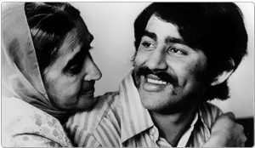

The finding that Ahmed Timol committed suicide and that “no one was to blame” cannot be sustained. This travesty of Justice should be corrected.
V

Slide 25
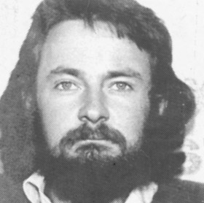
Similarly . . .
The finding that Neil Aggett committed
suicide and that “no one was to blame”
cannot be sustained. This travesty of Justice should be corrected.
Notes:
Thank you . . .

